Slide 1
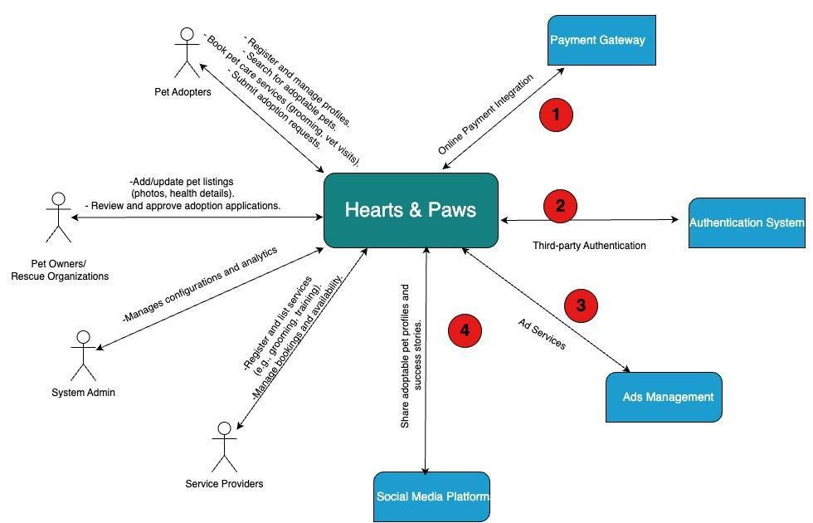
Team 4- Hearts & Paws- Context Diagram

Slide 2
System Interface Table
No | Description | Source | Target | Frequency | Validation
1a | Supports Online Payment | Payment Gateway | Hearts & Paws | Real- time | Transaction amounts against authorized limits; Verify payment statuses
1b | Provides Financial Data | Hearts & Paws | Payment Gateway | Real- time | Transaction details, payment statuses
2a | Third- Party Authentication | Authentication System | Hearts & Paws | Real- time | User account verification with authentication provider
2b | Provides User Authentication data | Hearts & Paws | Authentication System | Real- time | Ensure proper login credentials and token validation
3a | Sends Ads Services | Ads Management | Hearts & Paws | Real- time | Ads systematically displayed while user interacts with the platform
3b | Receives Ad performance | Hearts & Paws | Ads Management | Scheduled | Ensure accurate tracking and analytics of ad impressions
4a | Retrieves adoption engagement | Social Media Platforms | Hearts & Paws | Event- based | Validate engagement metrics and adoption interest
4b | Shares Adoptable pet profiles | Hearts & Paws | Social Media Platforms | Event- based | Ensure correct pet data is shared across platforms

